Slide 1
PERSONAL PROTECTIVE EQUIPMET (PPE) Unit-5

Slide 2

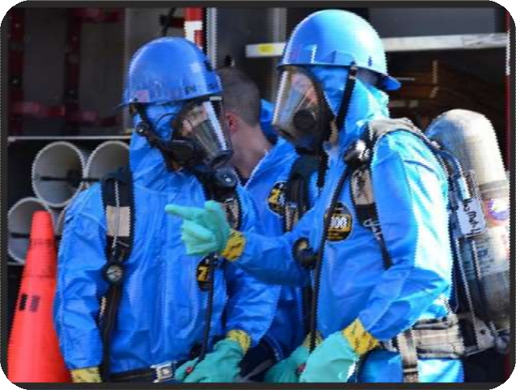
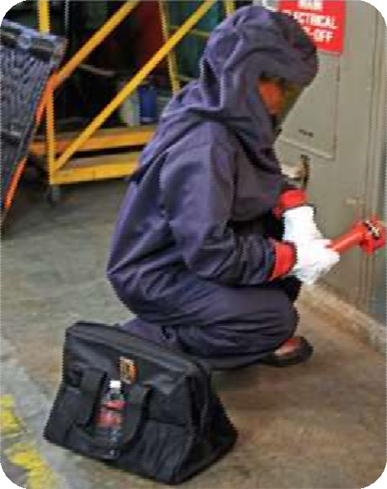
Introduction
Source of photos: OSHA

Slide 3
Introduction
Lesson objectives:
Describe the hierarchy of controls as it relates to personal protective equipment.
Identify types of personal protective equipment utilized in general industry.
Explain personal protective equipment training requirements.
Explain the employer responsibilities regarding personal protective equipment.
Explain the employee responsibilities regarding personal protective equipment.

Slide 4
Introduction
Employers must protect employees:
Assess the workplace
Eliminate and reduce the hazards found using engineering and administrative controls
Then use appropriate personal protective equipment
Remember, Personal Protective Equipment is the last level of control.

Slide 5
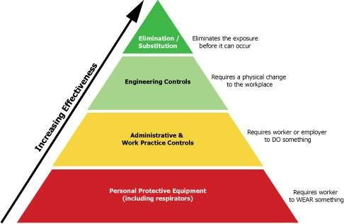
Hierarchy of Controls
Source: OSHA

Slide 6


Personal Protective Equipment
Eye & Face Protection
Head Protection
Hand Protection
Foot Protection
Body Protection

Slide 7

Is This An Appropriate Hard Hat?

Slide 8
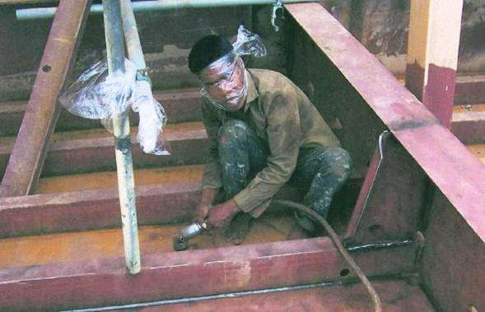
Is This An Appropriate Respirator?

Slide 9
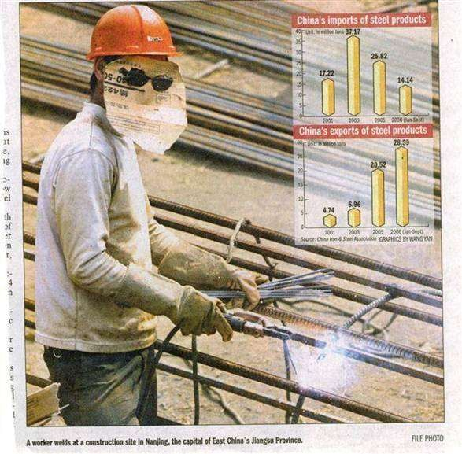
Is This an Appropriate Welder’s Mask?

Slide 10
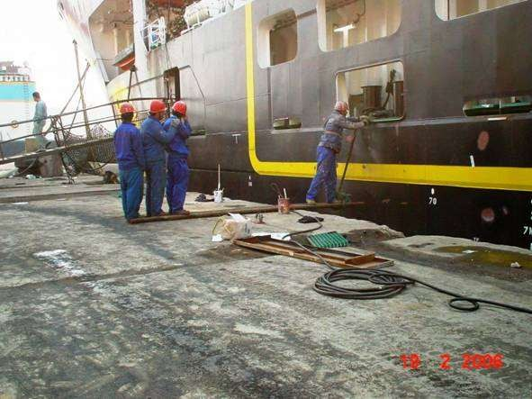
Is This an Appropriate Scaffolding?

Slide 11
Training
Employees required to use PPE must be trained to know at least the following
When PPE is necessary
What type of PPE is necessary
How to properly put on, take off, adjust, and wear
Limitations of the PPE
Proper care, maintenance, useful life and disposal

Slide 12
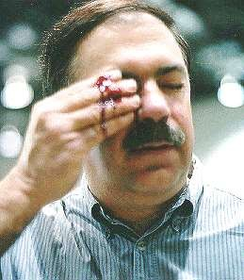

Slide 13
Eye and Face Protection
Why Eye and Face Protection is
Important
Thousands of people are blinded each year from work related eye injuries.
Injuries that could have been prevented, if only people would have used eye or face protection.

Slide 14
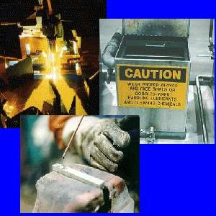
Eye and Face Protection
Types of eye/face
hazards
Impact
Heat
Chemicals
Dust
Light and/or Radiation

Slide 15

Eye and Face Protection
Potential Incidences of Eye/Face Hazards
Object Striking Eyes
Dusts, Powders, Fumes, and Mists
Small particles of matter can enter your eyes and damage them. Operations such as grinding, chiseling, sanding, hammering, and spraying can create small airborne particles
Contact with Chemicals
Toxic Gases, Vapors, and Liquids
Toxic chemicals in the form of gases, vapors, and liquids can damage your eyes. Always read the appropriate MSDS before working with any hazardous material.
Always check with your supervisor or safety manager to learn the type of eye or face protection you will need to use in order to work safely

Slide 16
Eye and Face Protection
Potential Incidences of Eye/Face Hazards
Swinging Objects
Large objects such as:
swinging chains, cables and ropes;
tools that are thrown or fall;
Thermal and Radiation Hazards
Operations such as welding, metal cutting, and working around furnaces can expose your eyes to heat, glare, ultraviolet, and infrared radiation

Slide 17
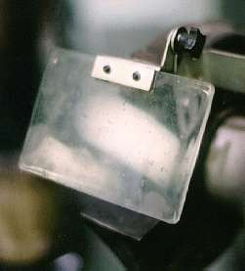
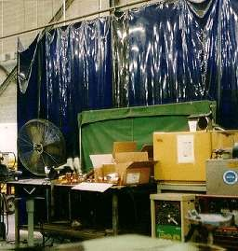
Eye and Face Protection
Elimination or Control of Hazards
Machine Guards
Many types of machines such as lathes, grinders, and sanders are equipped with guards, shields and screens
Work Area Barriers
Operations such as sanding, grinding, welding, and lathe
operations produce dust, vapors, and flying particles. To protect
other workers, work area barriers such as movable screens and
barriers should be set up to separate workers and bystanders
from hazardous operations

Slide 18
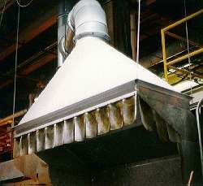
Eye and Face Protection
Elimination or Control of Hazards
Ventilation
Ventilation, along with damping systems, can significantly reduce the amount of airborne particles that could be hazardous to your eyes

Slide 19
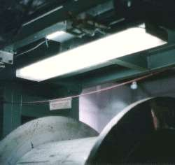
Lighting
Good lighting reduces eye strain and glare

Slide 20

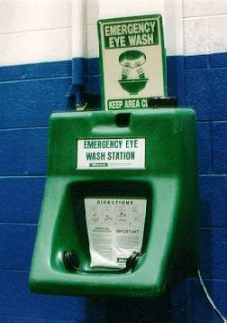
Eye and Face Protection
Elimination or Control of
Hazards
Signs and Warnings
Obstructions and protruding objects should be identified and marked
Eyewash Stations
Eyewash stations should be located within 100 feet of your work area. If you accidentally get something in your eyes, go directly to the eyewash station and flush your eyes with water for 15 minutes. Be sure to hold your eyes open with your fingers and "look" directly into the water streams.

Slide 21
Eye and Face Protection
Elimination or Control of Hazards
Safe Work Practices
Read and follow all warnings and precautions that may be found on equipment and hazardous materials
Do not throw tools or participate in horseplay
Keep sharp or pointed objects away from your eyes
Follow your supervisor's or safety
manager's suggestions and recommendations
for working safely

Slide 22
Eye and Face Protection
Proper Fit and Use of PPE
Must be right PPE for right job
Ex. Safety glasses are not sufficient eye protection for working with chemicals
Must stay on face during all work activities
Ex. Should not slide off face or pinch side of head and create a headache

Slide 23
Eye and Face Protection
TYPES OF EYES AND FACE PROTECTIVE EQUIPMENT
Safety Glass
Goggles
Face Shields
Welding Helmets
Absorptive Lenses

Slide 24
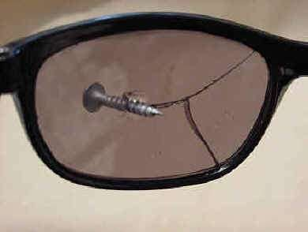
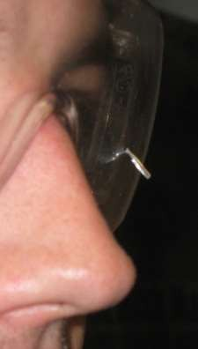
Eye and Face Protection
Regular glasses or sunglasses are not appropriate SAFETY GLASSES

Slide 25
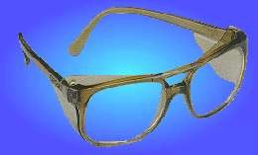
Eye and Face Protection
SAFETY GLASSES

Slide 26
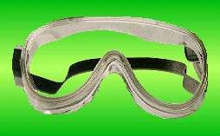
Eye and Face Protection
GOGGLES

Slide 27
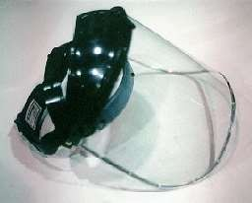
Eye and Face Protection
FACE
SHIELDS

Slide 28
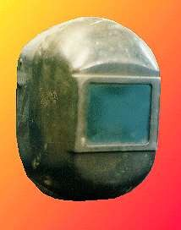
Eye and Face Protection
WELDING HELMETS

Slide 29
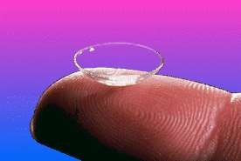
Eye and Face Protection
Safety Tip
Contact Lenses
Wear your contacts with caution if you work in areas where you might be exposed to fumes, dusts, powders, vapors, chemical splashes, molten metals, or intense heat, light or glare
Some chemicals can react with contacts and cause permanent injury

Slide 30
Eye and Face Protection
Care of Eye Protection Equipment
Clean your eye protection equipment. You can usually use mild soap and water
Never use abrasive soaps, rough paper, or cloth towels
Keep PPE in good working condition
If damaged, replace as soon as possible
Store your eye protection equipment in a sanitary, cool, dry area away from moisture
Read the manufacturer's directions and warnings before using any eye protection equipment
If you have any questions concerning your eye protection equipment, talk with your supervisor or safety manager

Slide 31

Head Protection
Why is Head Protection Important?
In and around your head are:
Your eyes, with which you see
Your ears, with which you hear
Your nose, with which you smell
Your mouth, with which you eat and speak
Your brain, with which you think
Injuries to the head are very serious. For this reason, head protection and safety are very important .

Slide 32
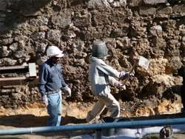
Head Protection
Types of Head hazards
Impact
Electric shock
Drips

Slide 33
Head Protection
Potential Incidences of Head Hazards
Impact
Falling or flying objects
falling or walking into hard objects
injuries include neck sprains, concussions, and skull fractures
Electric Shock
Live exposed electric wires
Injuries include electrical shocks and burns
Drips
Toxic liquids such as acids, caustics, and molten metals can irritate and burn the head/scalp.

Slide 34
Head Protection
Elimination or Control of Hazards
Safe Work Practices
Grounded equipment/shock resistant tools
Signs posted warning of hazards

Slide 35
Head Protection
Types of Head PPE
Hard Hats
Class A Hard Hat
Class B Hard Hat
Class C Hard hat
Bump Cups

Slide 36
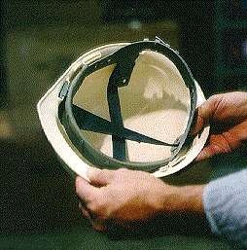
Head Protection
HARD HAT

Slide 37

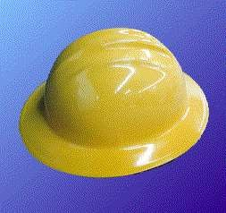

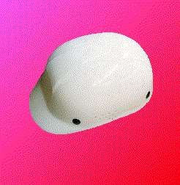
Head Protection
Class A Hard Hats
Class B Hard Hats
Class C Hard Hats
Bump Caps

Slide 38
Head Protection
Class A Hard Hats
Protect you from falling objects
Protect you from electrical shocks up to 2,200 volts
Class B Hard Hats
Protect you from falling objects
Protect you from electrical shocks up to 20,000 volts
Class C Hard Hats
Protect you from falling objects
Bump Caps
Bump caps are made from lightweight plastic and are designed to protect you from bumping your head on protruding objects

Slide 39
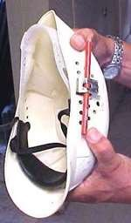
Head Protection
Modification of Hard Hat
Drilled holes for venting relief
Inserted pencil holder on hat for easy retrieval

Slide 40
Head Protection
Proper use and care of hard hat
Always wear your hard hat while you are working in areas where there are potential head hazards
Adjust the suspension inside your hard hat so that the hat sits comfortably, but securely on your head
Inspect the shell of your hard hat for cracks, gouges, and dents. Inspect the suspension system for frayed or broken straps. If your hard hat needs to be repaired, have it repaired immediately or ask your employer for a new one
Place plastic (non-metal) reflective tape on hat if working at night
Never paint, scratch or drill "air holes" in your hard hat
Never carry personal belongings such as cigarettes, lighters, or pens in your hard hat

Slide 41
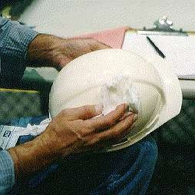
Head Protection
Care and Maintenance of Hard Hat
Clean your hard hat at least once a month by soaking it in a solution of mild soap and hot water for 5-10 minutes
Because sunlight and heat can damage
the suspension of your
hat, always store your hat in a clean, dry, and cool location

Slide 42
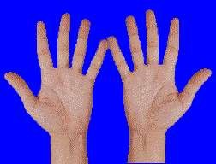
Hand Protection
Why is Hand Protection Important?
It has been estimated that almost 20% of all disabling accidents on the job involve the hands
Without your fingers or hands, your ability to work would be greatly reduced

Slide 43
Hand Protection
Types of Hand Hazards
Traumatic Injuries
Contact Injuries
Repetitive Motion Injuries

Slide 44
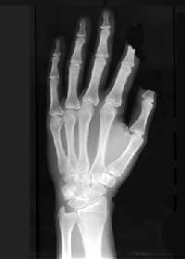
Hand Protection
Potential Incidences of
Hand Hazards
Traumatic Injuries
Tools and machines with a sharp edges can cut your hands.
Staples, screwdrivers, nails, chisels, and
stiff wire can puncture your hands.
Getting your hands caught in machinery can sprain, crush, or remove your hands and fingers

Slide 45
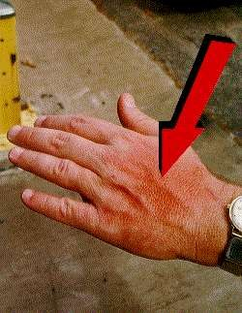
Hand Protection
Potential Incidences of Hand Hazards
Contact Injuries
Coming into contact with caustic or toxic chemicals, biological substances, electrical sources, or extremely cold or hot objects can irritate or burn your hands
WARNING: Toxic substances are poisonous substances that can be absorbed through your skin and enter your body.

Slide 46
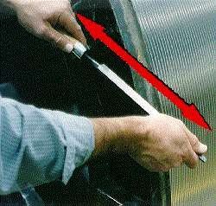
Hand Protection
Repetitive Motion Injuries Whenever you repeat the same hand movement over a long period of time, you run the risk of repetitive motion problems
Repetitive motion problems often appear as a numbness or tingling sensation accompanied by pain and the loss of gripping power in your hands

Slide 47
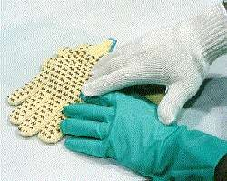
Hand Protection
Proper Fit and Use of PPE
Select and use the right kind of glove for the job you are going to be performing
Check fit, always use correct size
Make sure chemical resistant to chemical being used
Inspect your gloves before you use them
Remove any rings, watches, or bracelets that might cut or tear your gloves
Look for holes and cracks
that might leak
Replace gloves that are worn or torn

Slide 48
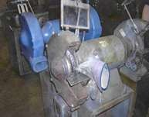
Hand Protection
Never wear gloves around powered rotating equipment - drills, lathes, etc

Slide 49
Hand Protection
Types of Hand PPE
GLOVES
Metal Mesh Gloves
Leather Gloves
Vinyl and Neoprene Gloves Rubber Gloves
Padded Cloth Gloves Heat Resistant Gloves Latex Disposable Gloves Lead Line Gloves
FOREARM CUFFS
THUMB GUARDS AND FINGER COTS
MITTENS
HAND PADS

Slide 50

Hand Protection
Metal mesh gloves
resist sharp edges and prevent cuts

Slide 51
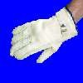
Hand Protection
Leather gloves
shield your hands from rough surfaces

Slide 52

Hand Protection
Vinyl and neoprene gloves
protect your hands against toxic chemicals

Slide 53
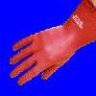
Hand Protection
Rubber gloves
protect you when working around electricity

Slide 54

Hand Protection
Padded cloth gloves
protect your hands from sharp edges, silvers, dirt, and vibration.

Slide 55

Hand Protection
Heat resistant gloves
protect your hands from heat and flames

Slide 56

Hand Protection
Latex disposable gloves
used to protect your hands from germs and bacteria

Slide 57

Hand Protection
Lead-lined gloves
used to protect your hands from radiation sources

Slide 58
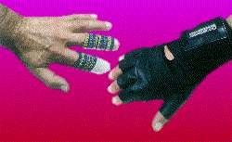
Hand Protection
Forearm Cuffs
used to protect your forearm
Thumb Guards and Finger Cots
protect only your thumb or
fingers
Mittens
protect your hands while working around very cold or hot materials
Hand Pads
Hand pads protect your hands while working around very hot materials

Slide 59
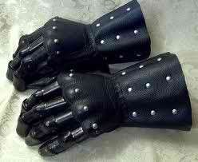
ARM PROTECTION
Gauntlets for workers handling corrosive substances, such as acids and caustics, shall be made of natural rubber, synthetic rubber or pliable plastic material resistant to corrosion.
Gauntlets for protecting workers against the action of toxic, irritating or infectious substances shall:
cover the forearm as much as possible,
have a close fit at the
upper end and
not have the slightest break. Gloves torn during use shall be replaced immediately
GAUNTLETS – gloves, w/c are closed-fittings to the hands

Slide 60
Safety Belts, Life Lines and Safety Nets
Workmen working in unguarded surface above open pits or tanks, steep slopes, moving machinery and similar locations, or working from unguarded surfaces six (6) meters (20 ft.) or more above water or ground, temporary or permanent floor platform, scaffold construction or where otherwise exposed to the possibility of falls hazardous to life or limb, shall be secured by safety belts and life lines. In situations where safety belts and life lines in guarded platforms and scaffolds or temporary floors are not feasible, safety nets shall be provided and installed.
Window washers or cleaners working outside buildings six (6) meters (20 ft.) or more above the ground or other surfaces unless protected from falling by other means, shall use safety belts attached to suitable anchors.

Slide 61
3.) Workmen entering a sewer, flue, duct, or other similarly confined places shall be provided and required to wear safety belts with life lines attached and held by another person stationed at the opening ready to respond to agreed signals.
4.) Workers who are required to climb and work on top of poles six (6) meters or more shall use safety belts. On top of structures where there is no place to strap a safety belt, a messenger line shall be installed for strapping the safety belt or life line.

Slide 62
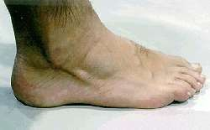
Foot Protection
Why is Foot Protection Important?
The human foot is rigid enough to support the weight of your entire body, and yet flexible enough to allow you to run, dance, play sports, and to take you anywhere you want to go. Without your feet and toes, your ability to work at your job would be greatly reduced.

Slide 63
Foot Protection
Types of Foot Hazards
Impact Injuries
Injuries from Spills and Splashes
Compression Injuries
Electrical Shocks
Extremes in Cold, Heat, and Moisture
Slipping

Slide 64
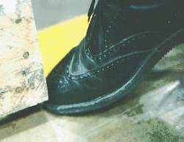
Foot Protection
Potential Incidences of Foot Hazards
Impact Injuries
At work, heavy objects can fall on your feet. If you work around sharp objects, you can step on something sharp and puncture your foot

Slide 65
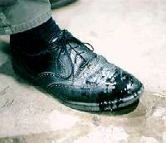
FOOT PROTECTION
Injuries from Spills and Splashes
Liquids such as acids, caustics, and molten metals can spill into your shoes and boots. These hazardous materials can cause chemical and heat burns

Slide 66
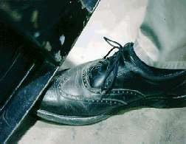
Foot Protection
Potential Incidences of Foot Hazards
Compression Injuries
Heavy machinery, equipment, and other objects can roll over your feet. The result of these types of accidents is often broken or crushed bones

Slide 67
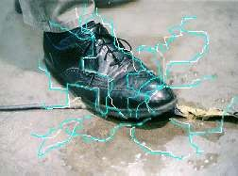
FOOT PROTECTION
Electrical Shocks
Accidents involving electricity can cause severe shocks and burns

Slide 68
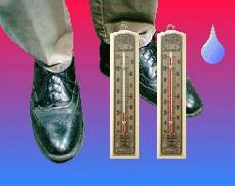
Foot Protection
Potential Incidences of Foot Hazards
Extremes in Cold, Heat, and Moisture
If not protected, your feet can suffer from frostbite if you must work in an extremely cold environment. Extreme heat, on the other hand, can blister and burn your feet. Finally, extreme moisture in your shoes or boots can lead to fungal infections

Slide 69
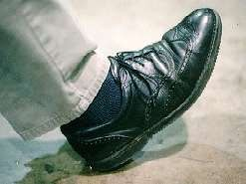
FOOT PROTECTION
Slipping
Oil, water, soaps, wax, and other chemicals can cause you to slip and fall

Slide 70
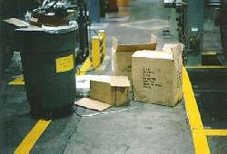
Foot Protection
Elimination or Control of Hazards
Housekeeping
Poorly maintained machinery, tools, sloppy work areas, and cluttered aisles all contribute to foot injuries
Signs
Identify temporary slip/trip areas

Slide 71
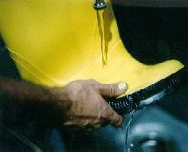
Foot Protection
Proper Fit and Use of PPE
Select and use the right kind of
footwear for the job you are
going to be performing.
Footwear should meet or exceed
the standards set by ANSI (ANSI Z41-1991)
Proper fit
Correct protection for job task
Inspect your footwear before
you use them
Look for holes and cracks that might leak
Replace footwear that are worn or torn
When working with chemicals
hose your footwear with water to
rinse away any chemicals or dirt before removing your footwear
Store footwear in a clean, cool, dry, ventilated area

Slide 72
Foot Protection
TYPES OF FOOT PPE
Safety Shoes and Boots
Steel Toe Footwear
Metatarsal Footwear
Reinforced Sole Footwear
Latex/Rubber Footwear
PVC Footwear
Butyl Footwear
Vinyl Footwear
Nitrile Footwear
Electrostatic Dissipating Footwear
Electrical Hazard Footwear
Disposable Footwear

Slide 73
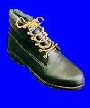
Foot Protection
Safety Shoes and Boots
Steel toe footwear
protects your toes from falling objects and from being crushed

Slide 74
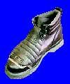
Foot Protection
Metatarsal footwear
special guards that run from your ankle to your toes and protect your entire foot

Slide 75

Foot Protection
Reinforced sole footwear
metal reinforcement that protects your foot from punctures

Slide 76

Foot Protection
Latex/Rubbe r footwear
resists chemicals and provides extra traction on slippery surfaces

Slide 77
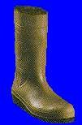
Foot Protection
Safety Shoes and Boots
PVC footwear
protects your feet against moisture and improves traction

Slide 78
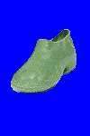
Foot Protection
Butyl footwear
protects against most ketones, aldehydes, alcohols, acids, salts, and alkalies

Slide 79
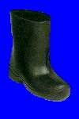
Foot Protection
Vinyl footwear
resists solvents, acids, alkalies, salts, water, grease, and blood

Slide 80

Foot Protection
Nitrile footwear
resists animal fats, oils, and chemicals

Slide 81

Foot Protection
Safety Shoes and Boots
Electrostatic dissipating footwear
conducts static electricity to floors that are grounded

Slide 82

Foot Protection
Electrical hazard footwear
insulated with tough rubber to prevent shocks and burns from electricity

Slide 83

Foot Protection
Disposable footwear
includes shower slippers, clear polyethylene and non-woven booties used in dust free work areas

Slide 84


Foot Protection
Employee ran over foot with lawn mower
Notice the damage to the shoe
The steel toe insert is lying in the grass next to perfectly fine toes
This employee received no injuries during this incident

Slide 85

Body Protection
Why is Body Protection Important?
The skin acts as a natural barrier to the elements
Chemicals can break down the skin barrier and allow secondary infections to manifest

Slide 86
Body Protection
TYPES OF BODY HAZARDS
Temperature stress
Chemical Contact
Radiation

Slide 87
Body Protection
Potential Incidences of Body Hazards
Temperature stress
Exposure to heat (hot metals) or cold (dry ice) which results in burns
Chemical Contact
Chemical splash
Contact with potentially infectious materials
Radiation

Slide 88
Body Protection
Elimination or Control of Hazards
Signage
Communication of hot/cold or radiation
Physical Barriers
Metal shielding or cement barrier
Splash guards on chemical hoods
Closed chemical systems

Slide 89

Body Protection
Proper Fit and Use of PPE
Select and use the
right kind of body
protection for the job
you are going to be performing
Make sure chemical
resistant to what working with
Inspect your
aprons/body shields before you use them
Store body protection
in a clean, cool, dry, ventilated area

Slide 90

Body Protection
Types of Body PPE
Insulated Coats and Pants
Fire resistant
Heat resistant
Cold resistant
Sleeves and Aprons
Work well when pouring or manipulating chemical to reduce splash
Make sure the sleeves and aprons are appropriate for the chemical

Slide 91


Body Protection
Types of Body Protection
Coveralls
Tyvek use for particulate filtering such as asbestos
Chemical rated
Full body suit
Hazardous materials handling
Carbon filtering for
emergency response

Slide 92

Body Protection

Slide 93




RESPIRATORY PPE
Respiratory protection:
Source of photos: OSHA
Please refer PDF for detailed study

Slide 94

Types of PPE
Elimination/substitution or Engineering controls
Eliminate toxic material or substitute a less toxic material
Enclose or confine operation
General or local exhaust ventilation
Only when engineering controls are not feasible, will respirators be used
Source: OSHA

Slide 95




Types of PPE
Types of respirators
Air-Purifying (APR) – remove contaminants from air
Particulate respirators
Chemical cartridge/ gas mask respirator
Powered Air-Purifying
Respirator (PAPR)
Source of photos: OSHA

Slide 96



Canister gas mask
Ammonia
Organic vapours and Acid gases
Acid gases
CO

Slide 97

Mechanical respirator
Larger particles
Retain very fine particles
<5 microns

Slide 98


Chemical respirator
Chemical catridge
Gas mask
0.1% contaminants
0.1 to 2% concentration of chemicals

Slide 99


Air supplying respirator
Atmosphere-Supplying – provide clean,
breathable air
Gas mask
Source of photos: OSHA

Slide 100


Air supplying respirator
Self-Contained Breathing Apparatus (SCBA)
Supplied-Air Respirator (SAR)

Slide 101
Types of PPE
Medical evaluation
Before fit tests are conducted and employee is authorized the use of a respirator, a medical evaluation must be provide to determine the ability of the employee to use a respirator.
Identify a physician or other license health care professional (PLHCP) to perform medical evaluations using a medical questionnaire or an initial medical evaluation with which the same information is obtained.

Slide 102


Types of PPE
Inspecting and cleaning respirators
Inspect all respirators for wear and tear before
and after each use
Wash in a detergent solution; then, disinfect by immersing in a sanitizing solution
Source of photos: Carmen Vazquez

Slide 103



Types of PPE
Storing respirators
Protect against dust, sunlight, heat, extreme cold, excessive moisture, and damaging chemicals
Store in position to retain natural configuration
Source of photos: Carmen Vazquez

Slide 104
Below is a list of foot and leg protection types matched with hazards they protect against. Which pairing is incorrect?
Leggings – heat hazards
Metatarsal guards – impact and compression
Electrically conductive shoes – static electricity build up
Foundry shoes – open circuits

Slide 105
Heat resistant gloves protect you from
Flames
Sharp edges
Electricity
Radiation

Slide 106
Eye protection is required for which of the following hazards? •
Flying particles
Molten metal
Liquid chemicals, acids or caustic liquids
All of the above

Slide 107
Metal mesh gloves used for
Flames and burns
Welding operation
Cutting operation

